Slide 1
Bootcamp_Data Engineering Training
Prepared By,
Srimathi Chandrasekaran
24/05/2022

Slide 2
Chapter2: Python Spark in Depth
Intro to Spark in Bigdata -> 21/05/2022
Spark components & Architecture -> 21/05/2022
Pyspark shell , Pyspark job & Spark Web UI -> Today 24/05/2022
Spark RDDs & DataFrames
Spark SQL & Spark Mllib
Spark GraphX

Slide 3
Apache Spark & PySpark latest version installation:
https://www.bing.com/videos/search?q=pyspark+shell+video+for+beginners+with+10+mins&&view=detail&mid=3A797C0CE14847A7C87A3A797C0CE14847A7C87A&&FORM=VRDGAR&ru=%2Fvideos%2Fsearch%3Fq%3Dpyspark%2Bshell%2Bvideo%2Bfor%2Bbeginners%2Bwith%2B10%2Bmins%26FORM%3DHDRSC3
Streaming Data Pipelines Demo - Create Spark Context and Spark Session
https://www.bing.com/videos/search?q=sparksession+and+spark+context&&view=detail&mid=2EA6661B82DD523B227F2EA6661B82DD523B227F&&FORM=VRDGAR&ru=%2Fvideos%2Fsearch%3Fq%3Dsparksession%2520and%2520spark%2520context%26qs%3Dn%26form%3DQBVRMH%26%3D%2525eManage%2520Your%2520Search%2520History%2525E%26sp%3D-1%26pq%3Dsparksession%2520and%2520spark%2520contex%26sc%3D2-29%26sk%3D%26cvid%3D07DEF8F765564DDDA504B03ED19EF997

Slide 4
Python Spark Shell – PySpark Shell
Spark Shell is an interactive shell through which we can access Spark’s API. Spark provides the shell in two programming languages : Scala and Python.
Prerequisites: Apache Spark is already installed on your local machine. If not, please refer Install Spark on Ubuntu or Install Spark on MacOS based on your Operating System.
PySpark Shell Key Points –
PySpark shell is referred as REPL (Read Eval Print Loop) which is used to quickly test PySpark statements.
Spark shell is available for Scala, Python and R (Java might be supported in previous versions).
The pyspark command is used to launch Spark with Python shell also call PySpark.
Use spark-shell command to work Spark with Scala.
The sparkr command is used to launch Spark with R language.
PySpark shell default provides spark and sc variables. spark is an object of SparkSession and sc is an object of SparkContext.
In PySpark shell, you cannot create your own SparkContext.

Slide 5
Start Spark Interactive Python Shell:
Python Spark Shell can be started through command line.
Launch PySpark Shell Command
Go to the Spark Installation directory from the command line and type bin/pyspark and press enter,
this launches pyspark shell and gives you a prompt to interact with Spark in Python language.
If you have set the Spark in a PATH then just enter pyspark in command line or terminal (mac users).
./bin/pyspark
It also supports several command-line options which I will cover in the below sections.

Slide 6
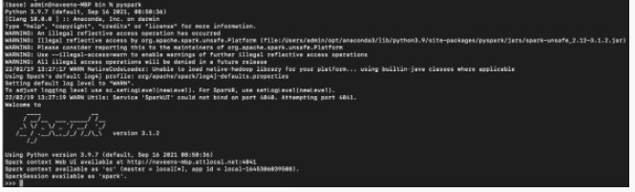
After running that command spark session will start in terminal like below:
Submit spark application to a cluster irrespective of language :
spark-submit

Slide 7
To exit from the pyspark shell use quit(), exit() or Ctrl-D (i.e. EOF).
Let’s understand a few statements.
By default, pyspark creates a Spark context which internally creates a Web UI with URL http://localhost:4040.
If it is unable to bind on 4040 , alternatively we can hit 4042 port.
Spark context created with app id local-*
By default it uses local[*] as master
Spark context and session are created with variables 'sc' and 'spark' respectively.
Displays Spark, and Python versions.

Slide 8
Spark Web UI – Understanding Spark Execution
Apache Spark provides a suite of Web UI/User Interfaces (Jobs, Stages, Tasks, Storage, Environment, Executors, and SQL) to monitor the status of your Spark/PySpark application, resource consumption of Spark cluster, and Spark configurations.
To better understand how Spark executes the Spark/PySpark Jobs, these set of user interfaces comes in handy. In this article, I will run a small application and explain how Spark executes this by using different sections in Spark Web UI.
Before going into Spark UI first, learn about these two concepts.
Transformations
Action
Let me give a small brief on those two, Your application code is the set of instructions that instructs the driver to do a Spark Job and let the driver decide how to achieve it with the help of executors.

Slide 9
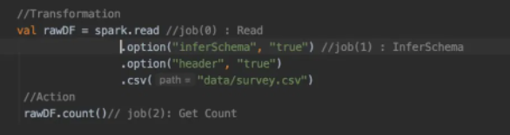
Instructions to the driver are called Transformations and action will trigger the execution.
Ex of a small application which does transformation and action.
Here we are creating a DataFrame by reading a .csv file and checking the count of the DataFrame. Let’s understand how an application gets projected in Spark UI

Slide 10
UI Tabs:
Spark UI is separated into below tabs.
Spark Jobs
Stages
Tasks
Storage
Environment
Executors
SQL

Slide 11
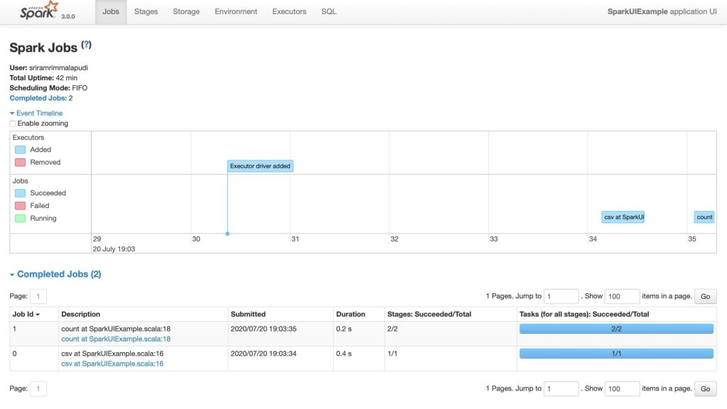
Additional UI’s that would be helpful to track Spark application.
Spark Application UI:
http://localhost:4040/
Resource Manager:
http://localhost:9870
Spark JobTracker:
http://localhost:8088/
Node Specific Info:
http://localhost:8042/
To access these URLs,
Spark application should
in running state.
If you wanted to access this URL regardless of your Spark application status and wanted to access Spark UI all the time, you would need to start Spark History server.

Slide 12
The details that I want you to be aware of under the jobs section are Scheduling mode, the number of Spark Jobs, the number of stages it has, and Description in your spark job.
Scheduling Mode
We have three Scheduling modes.
Standalone mode
YARN mode
Mesos

Slide 13
Number of Spark Jobs:
Always keep in mind, the number of Spark jobs is equal to the number of actions in the application and each Spark job should have at least one Stage.
In our above application, we have performed 3 Spark jobs (0,1,2)
Job 0. read the CSV file.
Job 1. Inferschema from the file.
Job 2. Count Check
So if we look at the fig it clearly shows 3 Spark jobs result of 3 actions.

Slide 14
Number of Stages
Each Wide Transformation results in a separate Number of Stages. In our case, Spark job0 and Spark job1 have individual single stages but when it comes to Spark job 3 we can see two stages that are because of the partition of data. Data is partitioned into two files by default.
1.4 Description
Description links the complete details of the associated SparkJob like Spark Job Status, DAG Visualization, Completed Stages.

Slide 15
Stages Tab
We can navigate into Stage Tab in two ways.
Select the Description of the respective Spark job (Shows stages only for the Spark job opted)
On the top of Spark Job tab select Stages option (Shows all stages in Application)
In our application, we have a total of 4 Stages.
The Stage tab displays a summary page that shows the current state of all stages of all Spark jobs in the spark application

Slide 16
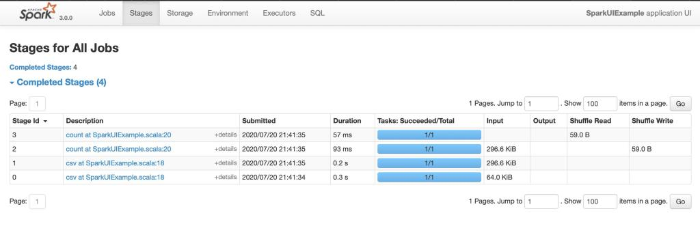
The number of tasks you could see in each stage is the number of partitions that spark is going to work on and each task inside a stage is the same work that will be done by spark but on a different partition of data.

Slide 17
Tasks
Spark Tasks Tab
Tasks are located at the bottom space in the respective stage.
Key things to look task page are:
1. Input Size – Input for the Stage
2. Shuffle Write-Output is the stage written.

Slide 18
Storage:
The Storage tab displays the persisted RDDs and DataFrames, if any, in the application.
The summary page shows the storage levels, sizes and partitions of all RDDs, and the details page shows the sizes and using executors for all partitions in an RDD or DataFrame.

Slide 19
Environment Tab
This environment page has five parts. It is a useful place to check whether your properties have been set correctly.
Runtime Information: simply contains the runtime properties like versions of Java and Scala.
Spark Properties: lists the application properties like ‘spark.app.name’ and ‘spark.driver.memory’.
Hadoop Properties: displays properties relative to Hadoop and YARN. Note: Properties like ‘spark.hadoop’ are shown not in this part but in ‘Spark Properties’.
System Properties: shows more details about the JVM.
Classpath Entries: lists the classes loaded from different sources, which is very useful to resolve class conflicts.

Slide 20
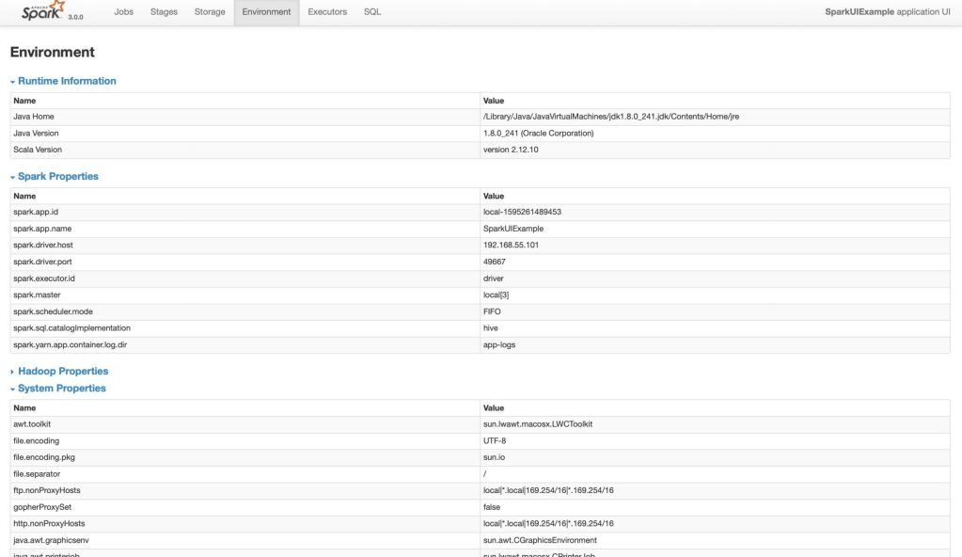
The Environment tab displays the values for the different environment and configuration variables, including JVM, Spark, and system properties.

Slide 21
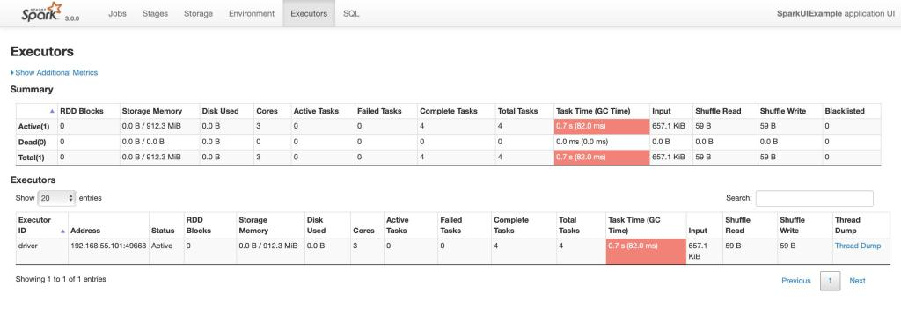
Executors Tab
The Executors tab displays summary information about the executors that were created for the application, including memory and disk usage and task and shuffle information. The Storage Memory column shows the amount of memory used and reserved for caching data.
The Executors tab provides not only resource information like amount of memory, disk, and cores used by each executor but also performance information.
In Executors: Number of cores = 3 as I gave master as local with 3 threads
Number of tasks = 4

Slide 22
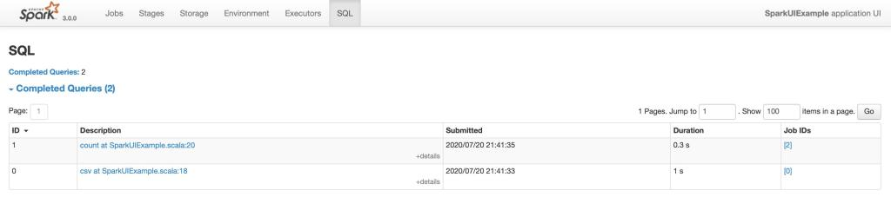
SQL Tab
If the application executes Spark SQL queries then the SQL tab displays information, such as the duration, Spark jobs, and physical and logical plans for the queries.
In our application, we performed read and count operation on files and DataFrame. So both read and count are listed SQL Tab.

Slide 23
Pyspark Tutorial | Introduction to Apache Spark with Python
https://www.bing.com/videos/search?q=pyspark+shell+video+for+beginners+with+10+mins&&view=detail&mid=4687CB83057D6F23AEC04687CB83057D6F23AEC0&&FORM=VRDGAR&ru=%2Fvideos%2Fsearch%3Fq%3Dpyspark%2Bshell%2Bvideo%2Bfor%2Bbeginners%2Bwith%2B10%2Bmins%26FORM%3DHDRSC3
First PySpark Application using pyspark shell
https://www.bing.com/videos/search?q=pyspark+shell+video+for+beginners+with+10+mins&&view=detail&mid=648400E66D3DBBC2FF42648400E66D3DBBC2FF42&&FORM=VRDGAR&ru=%2Fvideos%2Fsearch%3Fq%3Dpyspark%2Bshell%2Bvideo%2Bfor%2Bbeginners%2Bwith%2B10%2Bmins%26FORM%3DHDRSC3

Slide 24



